Slide 1
PRADIPTI CHATBOT
Guided By : Jayashree Bagade
Members:
Ishika Khatri
Ajinkya Pawar
Harshita Purohit
Kushal Barhate

Slide 2
PROBLEM STATEMENT
Enhancing Accessibility and Efficiency in Information Retrieval for Internship Programs and Passport Issuance through the Pradipti Chatbot.
The Airports Authority of India (AAI) manages various internship programs and collaborates with multiple enterprises to offer valuable learning opportunities to students across the country.
However, the current process of accessing detailed information about these internships is inefficient and cumbersome for users, including students and academic institutions.
Additionally, users often face challenges in finding accurate and up-to-date information about passport issuance procedures and requirements.

Slide 3
ABSTRACT
The Pradipti Chatbot is an AI-powered tool designed to streamline the process of finding internship opportunities with the Airports Authority of India (AAI) and to assist with passport-related inquiries. By providing a user-friendly, conversational interface, the chatbot automates responses to frequently asked questions, reduces redundant queries, and enhances the overall efficiency of information retrieval. It leverages natural language processing (NLP) to deliver personalized, accurate guidance on internship openings, eligibility criteria, application processes, and passport services, minimizing the need for manual searches and easing the burden on administrative resources. The Pradipti Chatbot aims to improve user satisfaction, engagement, and accessibility to essential information, fostering a more effective and responsive interaction between the AAI, educational institutions, and the public.

Slide 4
INTRODUCTION & SCOPE
The Pradipti Chatbot is made to respond to routine and simple inquiries by using up-to-date data from papers, databases, and pertinent background information.
Links to Standard Operating Procedures, MOU templates, and other materials housed on the websites of the Indian Aviation Academy (IAA) and the AAI are provided.
In addition, the chatbot may provide internship possibilities that are particular to both domains and airports, as well as email addresses for contacts at nearby airports depending on user requests.
Although there are no login restrictions, anybody may use the chatbot; nevertheless, in order to initiate interactions, it will need to know the user's name, phone number, and working email address. In order to enable individualized engagement, this guarantees a large user base while preserving a certain level of user identity.

Slide 5
USER CLASSES AND CHARACTERISTICS
Students
Seek clear-cut information on contact information.
Need details on application processes.
Look for accessible internship opportunities.
Institutions
Require comprehensive information about internship policies.
Need contact information for cooperation with companies and organizations.
Authorities/ Placement officers
Use the chatbot to access comprehensive information about internship policies.
Require contact information needed for cooperation with external entities.

Slide 6
LITERATURE SURVEY( existing systems)
1. Existing Chatbot Systems for Information Retrieval: Most existing chatbots are limited to handling predefined, narrow domains of questions, lacking flexibility and contextual understanding for more diverse or specific user inquiries.
2. Internship Information Platforms: Platforms like LinkedIn or Internshala provide broad internship listings but lack specificity for niche opportunities like those at the Airports Authority of India (AAI), and require manual searching.
3. Government Portals and Information Dissemination: Government websites typically use static formats that are difficult to navigate, lacking personalized, interactive features that could better assist users in finding specific information quickly.
The Pradipti Chatbot’s Differentiation: Pradipti offers specialized, real-time, and interactive information on AAI internships and passport queries, leveraging advanced NLP to provide customized responses and reducing administrative workloads through automation.

Slide 7
METHODOLOGY / ALGORITHMS / TECHNIQUES
1. Natural Language Processing (NLP): Utilizes NLP to understand and interpret user queries, enabling the chatbot to provide accurate and contextually relevant responses based on user intent.
2. Machine Learning (ML) for Contextual Understanding: Applies machine learning models to improve understanding of diverse user queries over time, allowing the chatbot to learn from interactions and enhance its accuracy and efficiency.
3.Rule-Based Systems: Integrates predefined rules and structured data for answering frequently asked questions about internships and passport queries, ensuring quick and consistent responses.
4. Information Retrieval Algorithms: Uses advanced search algorithms to pull relevant data from databases and documents, providing up-to-date information specific to AAI internships and passport procedures.
5. User Interface Design: Implements a user-friendly, accessible interface that combines interactive elements like FAQs and a chat window, ensuring seamless interaction and easy navigation for users.

Slide 8
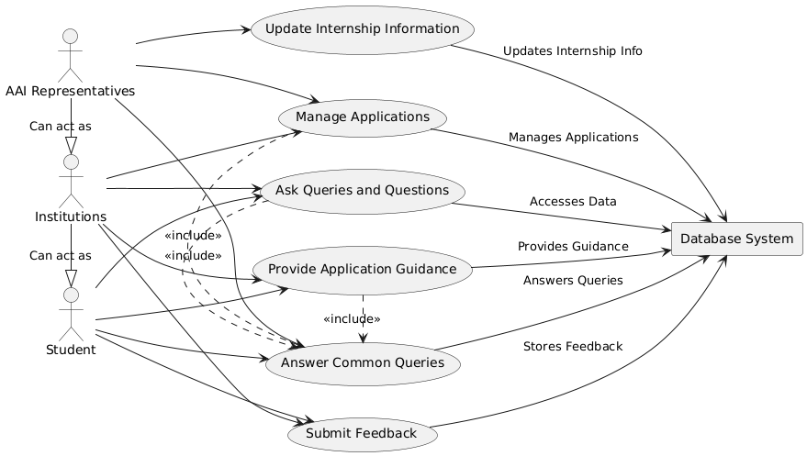
USE CASE DIAGRAM

Slide 9
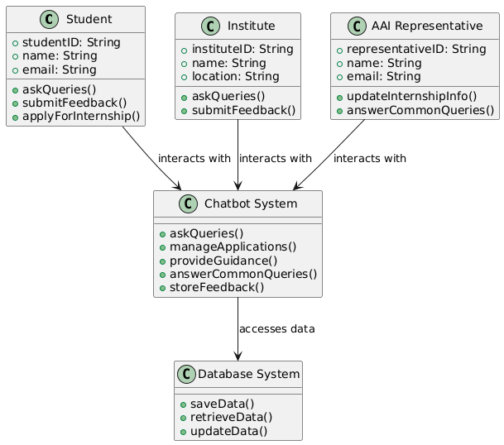
CLASS DIAGRAM

Slide 10
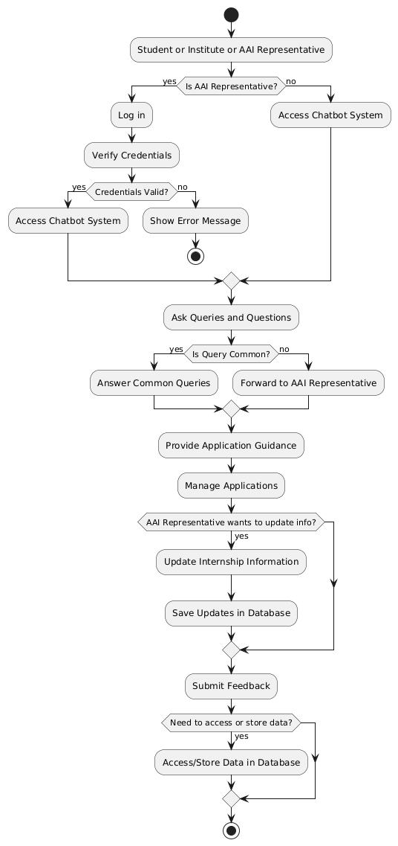
ACTIVITY DIAGRAM

Slide 11
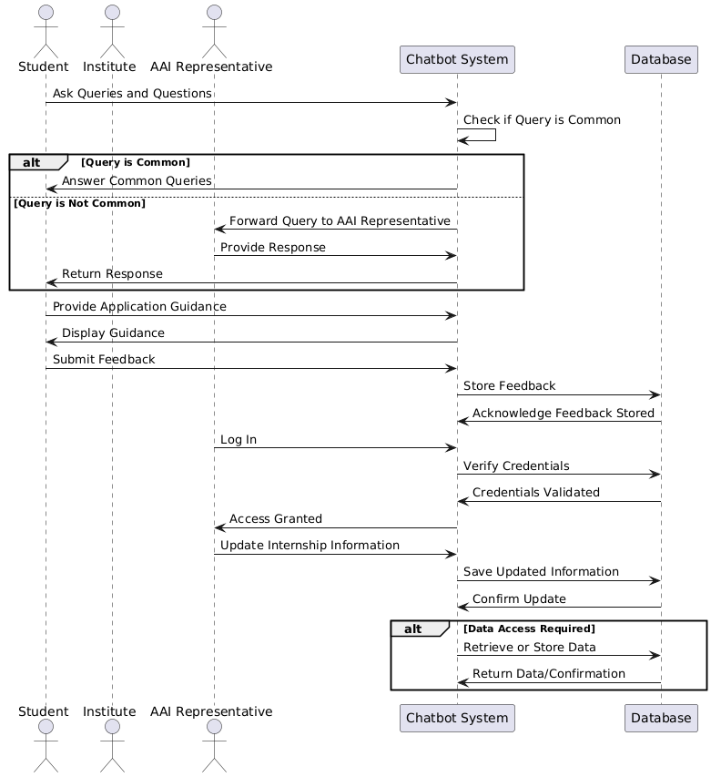
SEQUENCE DIAGRAM

Slide 12
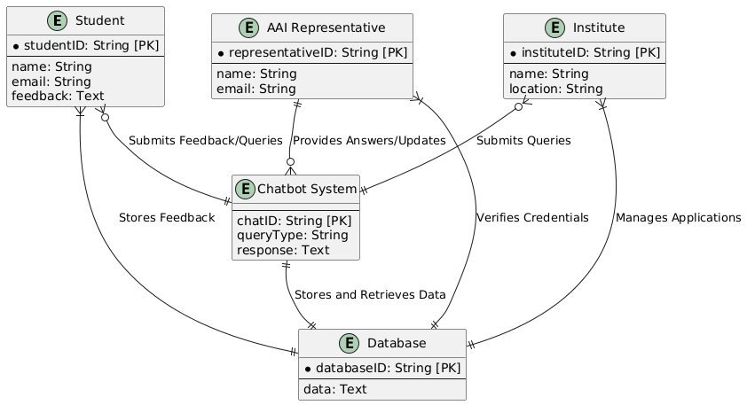
ENTITY-RELATIONSHIP DIAGRAM

Slide 13
MODULES SPILT – UP
1. User Interface (UI) Module : Develops a visually appealing and user-friendly interface for interaction, including the chat window and FAQs section, ensuring accessibility across devices.
2. Natural Language Processing (NLP) Module: Handles the understanding and processing of user queries by using NLP techniques to interpret text and provide relevant responses.
3. Response Generation Module: Formulates and delivers accurate responses by utilizing rule-based logic for common queries and machine learning for more complex or context-specific inquiries.
4. Database Integration Module: Connects to AAI's databases and external data sources to dynamically retrieve and update information regarding internships, openings, and passport services.
5. User Management Module: Manages user sessions, tracks interaction history, and personalizes responses based on past interactions while ensuring user privacy and data security.
6. Feedback and Improvement Module: Collects user feedback and analyzes conversation data to continuously improve chatbot responses and expand its knowledge base.

Slide 14
PROPOSED SYSTEM
The proposed system for the Pradipti Chatbot aims to streamline access to information regarding internships offered by the Airports Authority of India (AAI) and simplify passport-related queries.
The chatbot will provide a user-friendly interface where users, including students and institutions, can interact to receive instant, accurate responses.
By integrating Natural Language Processing (NLP) and machine learning algorithms, the system will understand diverse user queries, provide contextually relevant information, and improve its responses over time.
Additionally, it will employ rule-based logic to handle frequently asked questions efficiently and retrieve information dynamically from AAI's databases.
The chatbot will be designed to enhance user experience with an accessible, interactive interface that can handle multiple queries simultaneously, ensuring secure data management and user privacy throughout.

Slide 15
SOFTWARE TOOLS/ TECHNOLOGIES
Front-end Development: HTML, CSS, JavaScript, React.js for building the user interface and interactive components of the chatbot.
2. Back-end Development: Node.js, Express.js for server-side scripting and handling API requests between the chatbot and databases.
3. Natural Language Processing (NLP): Python with libraries like NLTK, SpaCy, or TensorFlow for text processing, sentiment analysis, and intent recognition.
4. Database Management: MySQL or MongoDB for storing user data, FAQs, and other relevant information required by the chatbot.
5. Machine Learning: Python with frameworks like TensorFlow or PyTorch for training models to improve chatbot accuracy and personalization.

Slide 16
SOFTWARE TOOLS/ TECHNOLOGIES
6. Cloud Services: AWS or Azure for deploying the chatbot, managing data storage, server hosting, and handling large-scale queries.
7. API Integration: RESTful APIs for connecting with external data sources like AAI databases and third-party services.
8. Security Tools: SSL/TLS for secure data transmission, OAuth for authentication, and encryption tools to protect sensitive user data.
9. Version Control: Git and GitHub for code management, collaboration, and version control.
10. Testing and Debugging: Jest, Mocha, or Selenium for testing chatbot functionalities and ensuring a bug-free user experience.

Slide 17
Proposed Outcomes
The proposed outcomes for the Pradipti Chatbot include significantly enhancing user access to information about internships and job openings at Airports Authority of India (AAI) through an interactive and user-friendly interface.
The chatbot will automate and streamline query resolution, improve response times, and reduce the workload on customer service teams.
It aims to provide a scalable solution capable of handling high volumes of interactions, offer data-driven insights for service improvements, and simplify complex processes related to internships and passport services.
Additionally, the system will ensure secure handling of user information, enhancing overall user experience and efficiency.

Slide 18
PROJECT PLAN 2.0
WEEK | ACTIVITY
WEEK 1 | Planning & Initiation
WEEK 2 | Understanding Requirements
WEEK 3 | Wireframe
WEEK 4 | Testing with sample database
WEEK | ACTIVITY
WEEK 5-9 | Development
WEEK 10 | Working with actual database.
WEEK 11 | Adjustments.
WEEK 12 | Final Review.

